Slide 1
English for preschoolers

Slide 2
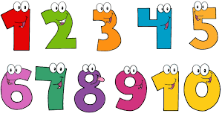
Numbers 1 to 10

Slide 13
LET’S COUNT TOGETHER!

