Slide 1
ENGLISH 8TH GRADE
MISS: MARÍA FERNANDA FERNÁNDEZ JELDRES

Slide 2
OBJECTIVE: TO IDENTIFY COMPARATIVE ADJECTIVES.
OBJETIVO: IDENTIFICAR ADJETIVOS COMPARATIVOS.
WHAT COUNTRIES OR NATIONALITIES DO YOU REMEMBER?

Slide 3
COUNTRIES AND NATIONALITIES
BRAZILIAN
AUSTRALIAN
CHILEAN

Slide 4
COUNTRIES AND NATIONALITIES.
FINNISH
JAPANESE
INDIAN
CHINESE
FRANCE

Slide 5
COMPARATIVES AND SUPERLATIVES.

Slide 6
COMPARATIVE RULES

Slide 7
COMPARATIVE RULES

Slide 8
COMPARATIVE RULES

Slide 9
COMPARATIVES RULES

Slide 10
COMPARATIVE RULES

Slide 11
COMPARATIVE RULES

Slide 12
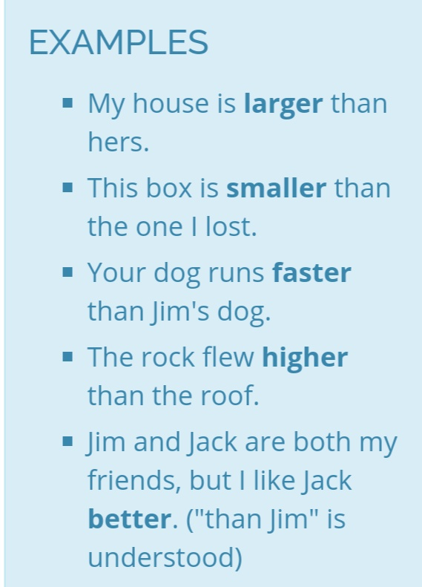
LET’S READ THESE SENTENCES TOGETHER AND FIND THE COMPARATIVE ADJETIVE.

Slide 13
LET’S COMPLETE THESE SENTENCES TOGETHER.

Slide 14
DO YOU HAVE ANY QUESTION ABOUT THE PREPOSITIONS OF PLACE?

Slide 15
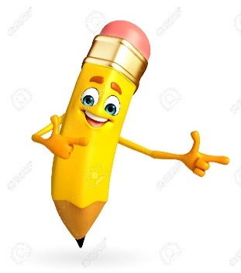
NOW LET’S SEE THE WORKSHEET.

