Slide 1
ENGLISH 5th GRADE
MISS MARÍA FERNANDA FERNÁNDEZ JELDRES

Slide 2
OBJECTIVE: TO LEARN food’S VOCABULARY IN ENGLISH.
OBJETIVO: APRENDER VOCABULARIO SOBRE comida EN INGLÉS.
DO YOU KNOW AN ANIMAL IN ENGLISH?

Slide 3
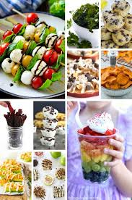
food

Slide 4
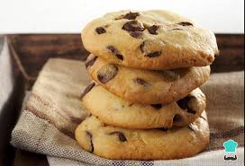
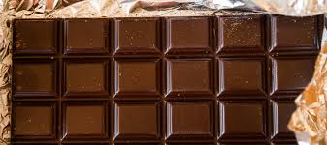
ANIMAL’S VOCABULARY
ENGLISH WORD | MEANING | PRONUNCIATION
CHOCOLATE | CHOCOLATE | CHOKOLEIT
BISCUITS | GALLETAS | BISKUITS

Slide 5
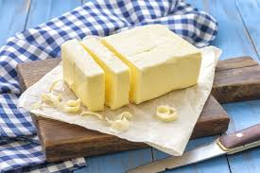
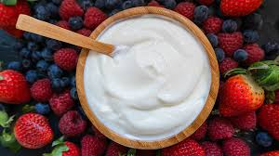
ANIMAL’S VOCABULARY
ENGLISH WORD | MEANING | PRONUNCIATION
BUTTER | MANTEQUILLA | BATER
CREAM | CREMA | KRIM

Slide 6
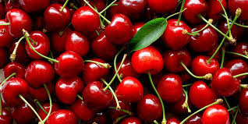
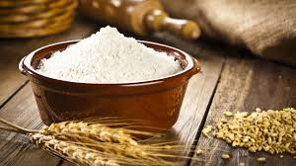
ANIMAL’S VOCABULARY
ENGLISH WORD | MEANING | PRONUNCIATION
CHERRIES | CEREZAS | CHERRIS
FLOUR | HARINA | FLAGUER

Slide 7
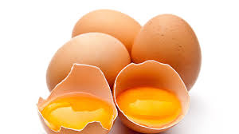
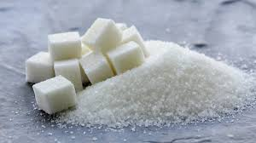
ANIMAL’S VOCABULARY
ENGLISH WORD | MEANING | PRONUNCIATION
EGGS | HUEVOS | EGS
SUGAR | AZÚCAR | SHUGAR

Slide 8
HAVE GOT (Tener)

Slide 9
Look at this example

Slide 10
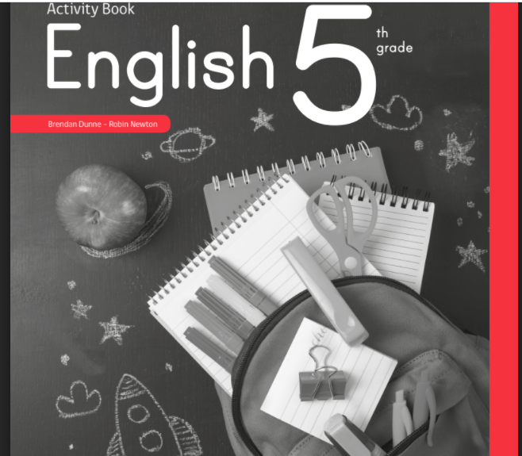
WE ARE GOING TO USE THIS “ACTIVITY BOOK”

Slide 11
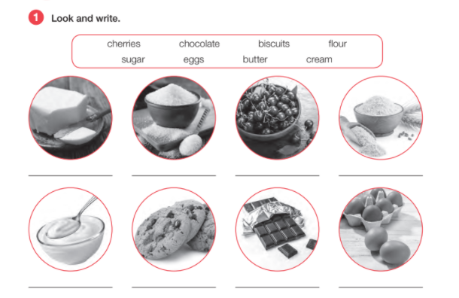
NOW IN YOUR ACTIVITY BOOK ON PAGE 14…

Slide 12
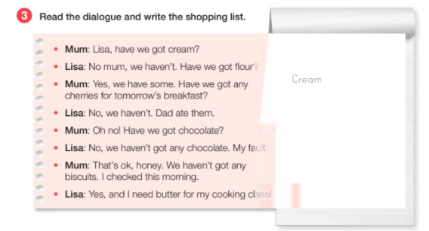
ON PAGE 15

Slide 13
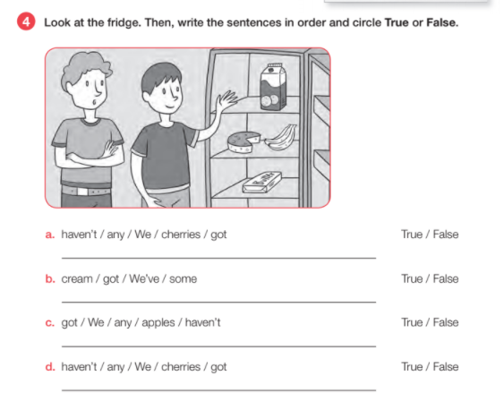
BY LAST ON PAGE 15, exercise 4, YOU HAVE TO DO THIS.

Slide 14
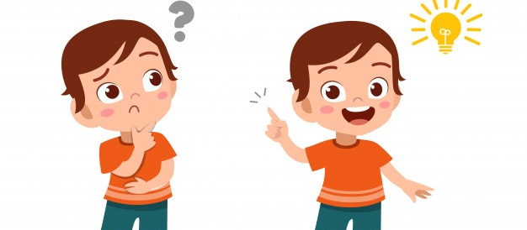
Do you have questions about food’s vocabulary or the have got?.

Slide 15
