Slide 1
English 5th grade
MISS MARIA FERNANDA FERNÁNDEZ JELDRES

Slide 2
Objective: to identify the parts of the house and the house/DAILY routines.
OCTOBER 2ND, 2020
OBJETIVO: IDENTIFICAR LAS PARTES DE LA CASA Y LAS RUTINAS DIARIAS Y/O DE LA CASA.
WHAT PARTS OF THE HOUSE DO YOU REMEMBER?
WHAT HOUSE/ DAILY ROUTINES DO YOU REMEMBER?

Slide 4
PARTS OF THE HOUSE VOCABULARY
ENGLISH WORD | MEANING | PRONUNCIATION
LIVING ROOM | SALA DE ESTAR | LIVIN RUM
BATHROOM | BAÑO | BADRUM
BEDROOM | DORMITORIO | BEDRUM
KITCHEN | COCINA | KITCHEN
DINING ROOM | COMEDOR | DAININ RUM
GARAGE | COCHERA | GARACH
HALL | ENTRADA | JOL
ATTIC | ATICO | ATIK

Slide 5
HOUSE/DAILY ROUTINES VOCABULARY
ENGLISH WORD | MEANING | PRONUNCIATION
TIDY MY ROOM | ORDENAR LA PIEZA | TAIDI MAI RUM
DO MY HOMEWORK | HACER LA TAREA | DU MAI JOMGUORK
DO THE DISHES | LAVAR LOS PLATOS | DU DE DISHES
WORK ON THE COMPUTER | TRABAJAR EN EL COMPUTADOR | GUORK ON DE COMPIURER
WATCH TV | VER TELEVISION | GUATCH TIVI
CHAT WITH FRIENDS | HABLAR CON AMIGOS | CHAT GUID FRENDS

Slide 7
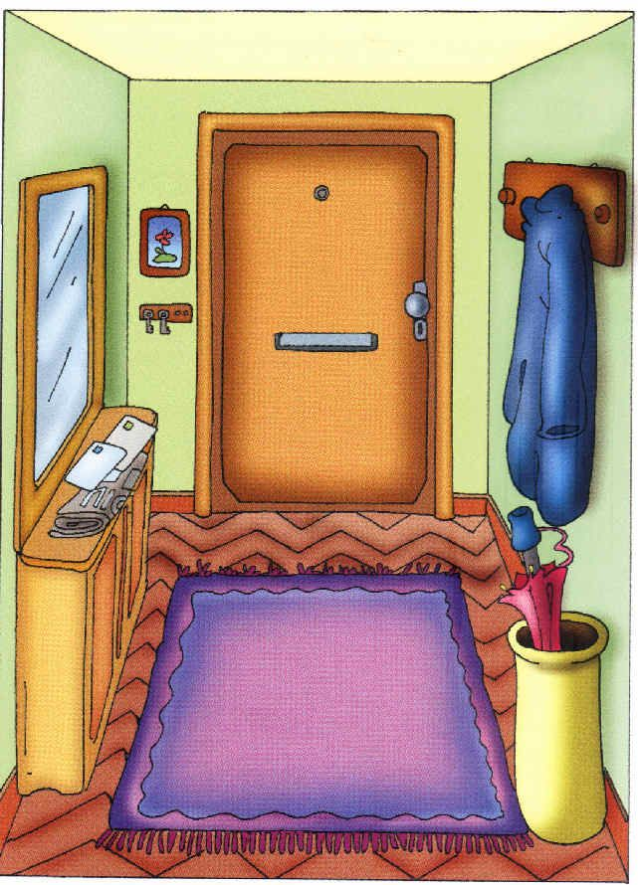
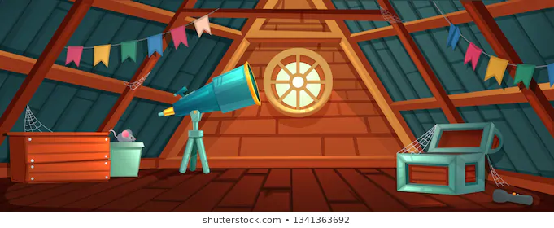
GARAGE HALL ATTIC

Slide 8
Tidy my room
Do the dishes

Slide 9
SOME EXAMPLES
I TIDY MY CLOTHES IN MY BEDROOM

Slide 10
SOME EXAMPLES
I DO THE DISHES IN THE KITCHEN

Slide 11
SOME EXAMPLES
I WATCH TV IN THE LIVING ROOM.

Slide 12
SOME EXAMPLES
I CHAT WITH MY FRIENDS IN MY BEDROOM.

Slide 13
If you have any questions, ask me!

