Slide 1
ENGLISH 4TH GRADE
MISS MARÍA FERNANDA FERNÁNDEZ JELDRES

Slide 2
OBJETIVE: TO LEARN THE VOCABULARY ABOUT MEANS OF TRANSPORTATION AND ITS CLASIFICATION.
OBJETIVO: APRENDER EL VOCABULARIO SOBRE LOS MEDIOS DE TRANSPORTE Y SU CLASIFICACIÓN.
DO YOU KNOW ANY MEANS OF TRANSPORTATION IN ENGLISH?

Slide 3
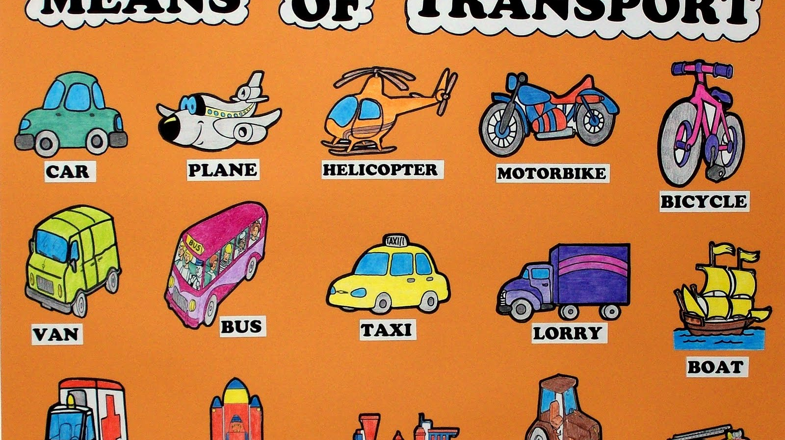
MEANS OF TRANSPORT.

Slide 4
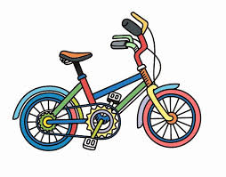
MEANS OF TRANSPORTATION VOCABULARY.
ENGLISH WORD | MEANING | PRONUNCIATION
BYCICLE | BICICLETA | BAICIKEL
CAR | AUTO | KAR

Slide 5
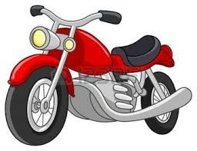
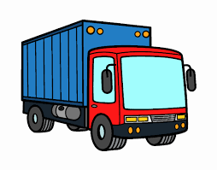
Means of transportation VOCABULARY
ENGLISH WORD | MEANING | PRONUNCIATION
MOTORBIKE | MOTOCICLETA | MOTORBAIK
TRUCK/ LORRY | CAMIÓN | TRAK / LORRI

Slide 6
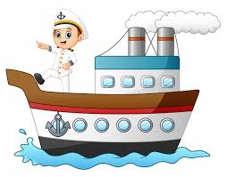
MEANS OF TRANSPORTATION VOCABULARY.
ENGLISH WORD | MEANING | PRONUNCIATION
SHIP | BARCO | SHIP
BOAT | BOTE | BOUT

Slide 7
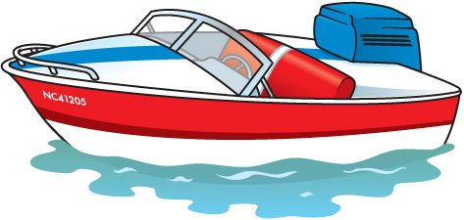
MEANS OF TRANSPORTATION VOCABULARY.
ENGLISH WORD | MEANING | PRONUNCIATION
SUBMARINE | SUBMARINO | SUBMARIN
MOTOR BOAT | BOTE A MOTOR | MOTORBOUT

Slide 8
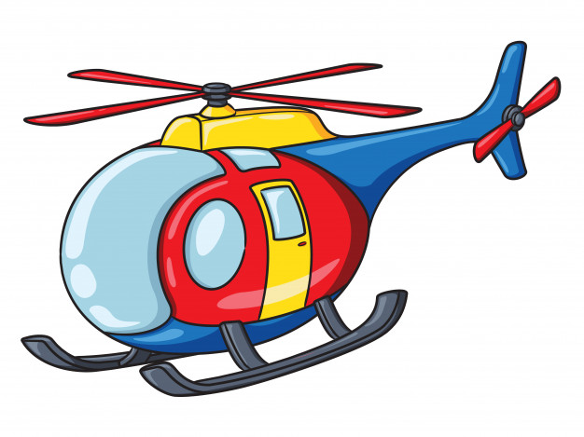
MEANS OF TRANSPORATION VOCABULary.
ENGLISH WORD | MEANING | PRONUNCIATION
HELICOPTER | HÉLICOPTERO | JELIKOPTER
PLANE | AVIÓN | PLEIN

Slide 9
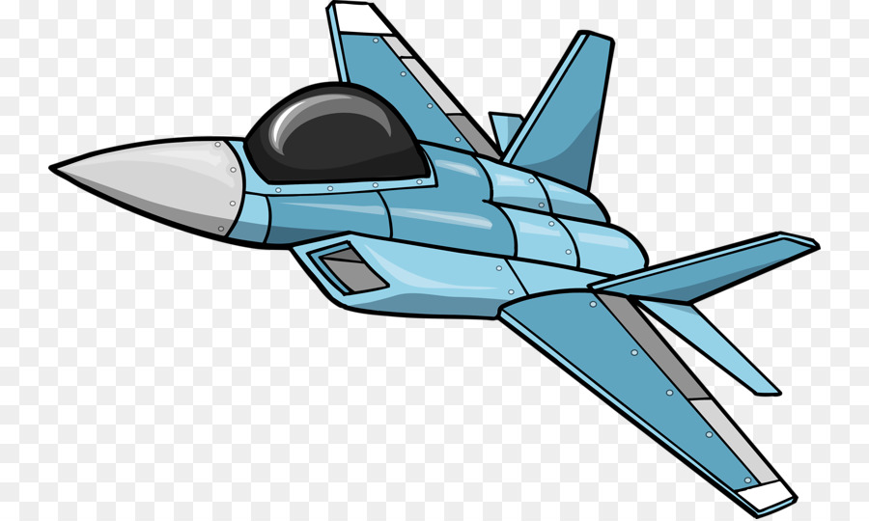
MEANS OF TRANSPORTATION VOCABULARY.
ENGLISH WORD | MEANING | PRONUNCIATION
HOT AIR BALLON | GLOBO AEROSTATICO | JOT ER BALUN
JET PLANE | AVION DE GUERRA | YET PLEIN

Slide 10
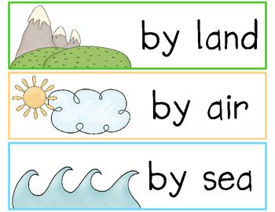
MEANS OF TRANSPORTATION CAN BE CLASSIFY

Slide 11
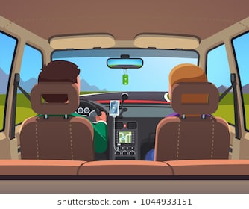
SOME EXAMPLES
A CAR TRAVELS BY LAND.

Slide 12
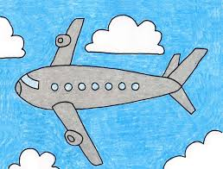
SOME EXAMPLES
A PLANE TRAVELS BY AIR.

Slide 13
SOME EXAMPLES.
A SHIP TRAVELS BY WATER.

Slide 14
LET’S CLASSIFY SOME MEANS OF TRANSPORTATION.
BY LAND | BY AIR | BY SEA
CAR PLANE SHIP BYCICLE HELICOPTER MOTORBOAT
MOTORBIKE HOT AIR BALLON SUBMARINE TRUCK BOAT
JET PLANE

Slide 15
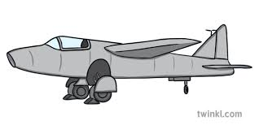
EXIT TICKET!
Helicopter
Plane
Hot air ballon
Boat
Ship
Motorboat
Plane
Jet plane
Helicopter
Car
Bycicle
Truck
Ship
Submarine
Boat

