Slide 1
ENGLISH 3RD GRADE
MISS MARÍA FERNANDA FERNÁNDEZ JELDRES

Slide 2
OBJECTIVE: TO LEARN THE PARTS OF A HOUSE.
OBJETIVO: APRENDER LAS PARTES DE LA CASA.
DO YOU KNOW A PART OF A HOUSE IN ENGLISH?

Slide 3
PARTS OF THE HOUSE VOCABULARY
ENGLISH WORD | MEANING | PRONUNCATION
LIVING ROOM | SALA DE ESTAR | LIVIN RUM
DINING ROOM | COMEDOR | DAININ RUM
BEDROOM | DORMITORIO | BEDRUM
BATHROOM | BAÑO | BADRUM

Slide 5
Parts of the house vocabulary
ENGLISH WORD | MEANING | PRONUNCIATION
GARAGE | COCHERA | GARACH
HALL | PASILLO/ENTRADA | JOL
ATTIC | ÁTICO | ATIK

Slide 6
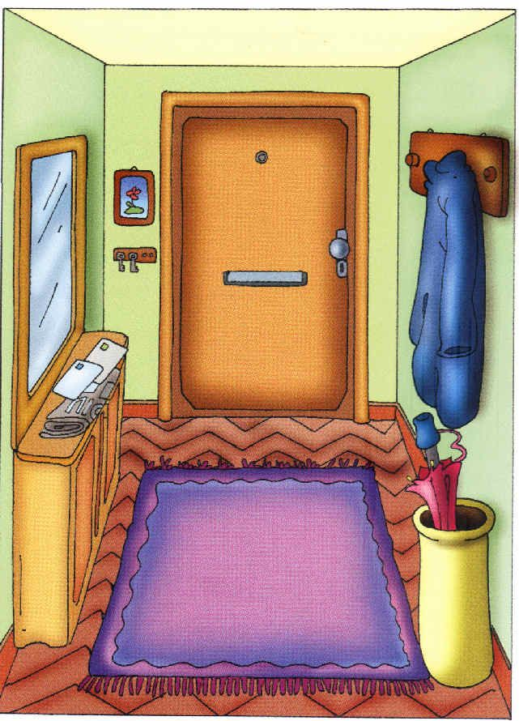
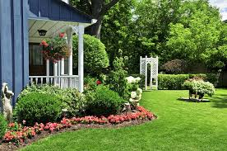
GARAGE HALL garden

Slide 7
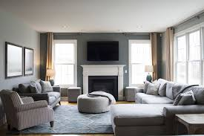
SOME EXAMPLES
THERE IS A TV IN MY LIVING ROOM.

Slide 8
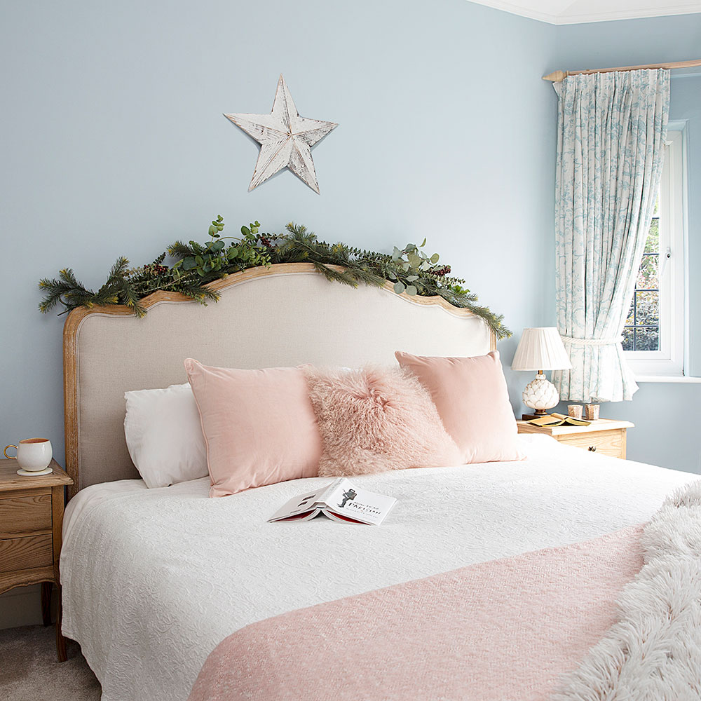
SOME EXAMPLES
THERE IS A BED IN MY BEDROOM.

Slide 9
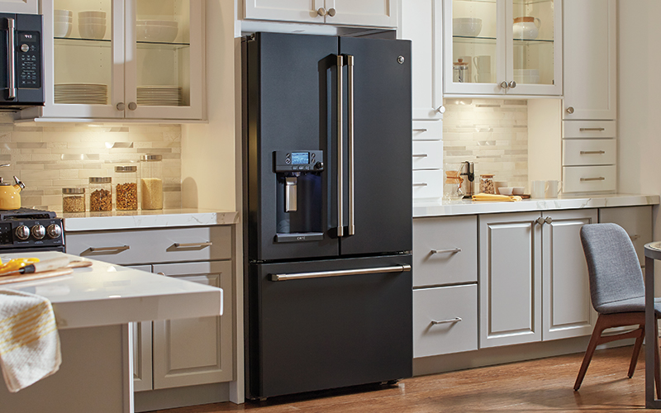
SOME EXAMPLES
THERE IS A FRIDGE IN MY KITCHEN.

Slide 10
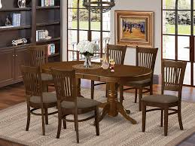
SOME EXAMPLES
THERE ARE CHAIRS AND A TABLE N MY DINING ROOM.

Slide 11
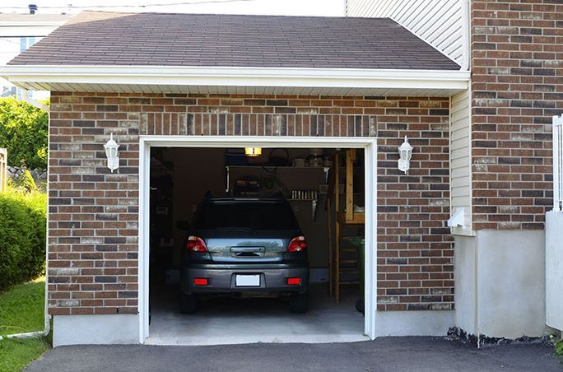
SOME EXAMPLES
THERE IS A CAR IN MY GARAGE.

Slide 12
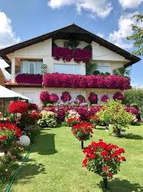
SOME EXAMPLES
THERE ARE FLOWERS IN MY GARDEN.

Slide 13
LET’S COMPLETE THESE PARTS OF A HOUSE.
GARDEN BATHROOM BEDROOM HALL LIVING ROOM KITCHEN GARAGE

Slide 14
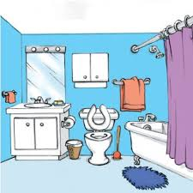
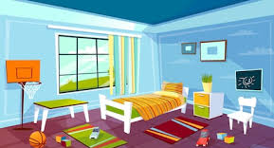
EXIT TICKET!
Bedroom
Living room
Dining room
Bathroom
Kitchen
Bedroom
Bathroom
Bedroom
Garage

Slide 15
DO YOU HAVE ANY QUESTION ABOUT THE Parts of a house?

