Slide 1
ENGLISH 1ST GRADE
MISS MARÍA FERNANDA FERNÁNDEZ JELDRES

Slide 2
OBJECTIVE: TO LEARN ANIMAL’S VOCABULARY IN ENGLISH.
OBJETIVO: APRENDER VOCABULARIO SOBRE ANIMALES EN INGLÉS.
DO YOU KNOW AN ANIMAL IN ENGLISH?

Slide 3
ANIMALS

Slide 4
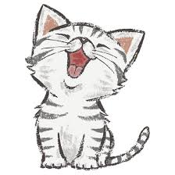
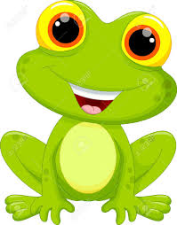
ANIMAL’S VOCABULARY
ENGLISH WORD | MEANING | PRONUNCIATION
FROG | RANA | FROG
CAT | GATO | KAT

Slide 5
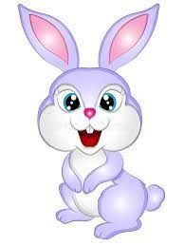
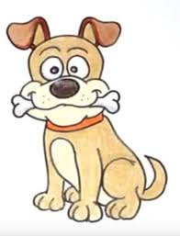
ANIMAL’S VOCABULARY
ENGLISH WORD | MEANING | PRONUNCIATION
RABBIT | CONEJO | RABIT
DOG | PERRO | DOG

Slide 6
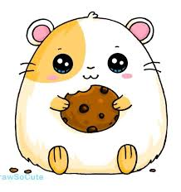
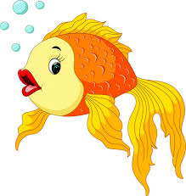
ANIMAL’S VOCABULARY
ENGLISH WORD | MEANING | PRONUNCIATION
HAMSTER | HAMSTER | JAMSTER
GOLDFISH | PEZ DORADO | GOLDFISH

Slide 7
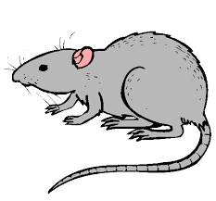
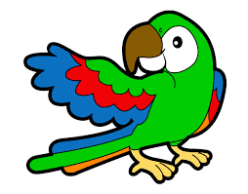
ANIMAL’S VOCABULARY
ENGLISH WORD | MEANING | PRONUNCIATION
RAT | RATA | RAT
PARROT | LORO | PARROT

Slide 8
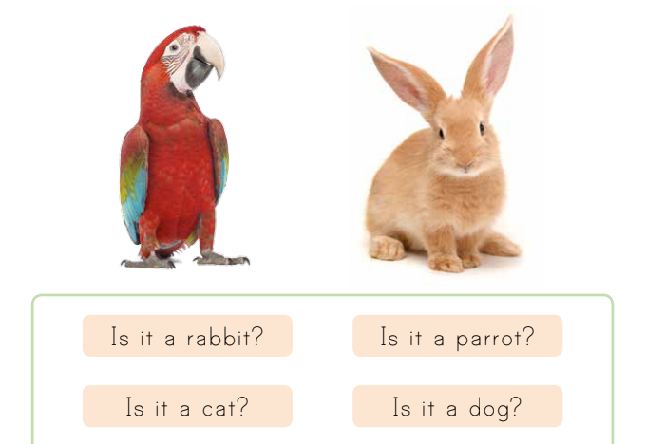
LET’S LOOK SOME EXAMPLES OF QUESTIONS ABOUT ANIMALS.

Slide 9
WE CAN ANSWER USING…

Slide 10
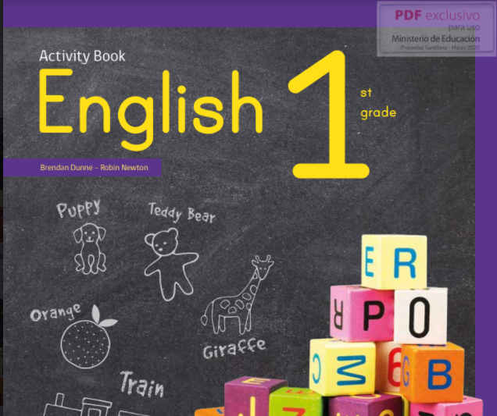
WE ARE GOING TO USE THIS “ACTIVITY BOOK”

Slide 11
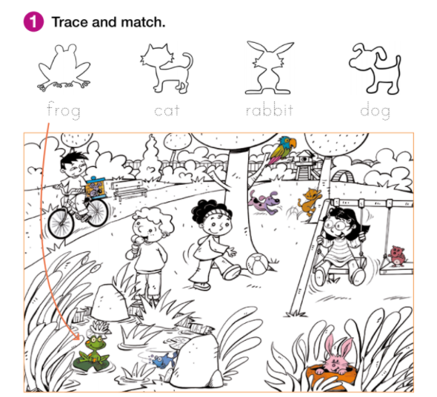
NOW IN YOUR ACTIVITY BOOK ON PAGE 26…

Slide 12
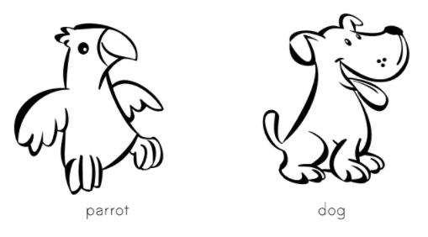
ON PAGE 27

Slide 13
BY LAST ON PAGE 31 YOU HAVE TO DO THIS.

Slide 14
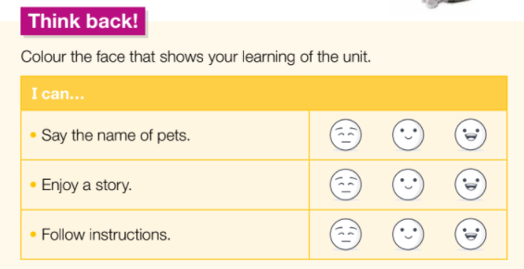
AS A CONCLUSION FOR YOUR LEARNING OF THIS UNIT, ANSWER WITH THESE FACES.

Slide 15
