Slide 1
English 1st grade
MISS MARIA FERNANDA FERNANDEZ JELDRES

Slide 2
LET’S SING THE HELLO SONG!

Slide 3
OBJECTIVE: TO IDENTIFY THE MEMBERS OF THE FAMILY.
SEPTEMBER 30TH,2020
OBJETIVO: IDENTIFICAR LOS MIEMBROS DE LA FAMILIA.
What members of the family do you remember?

Slide 5
MEMBERS OF THE FAMILY VOCABULARY
ENGLISH WORD | MEANING | PRONUNCIATION
GRANDFATHER | ABUELO | GRANFADER
GRANDMOTHER | ABUELA | GRANMADER
MOTHER | MADRE | MADER
FATHER | PADRE | FADER
BROTHER | HERMANO | BRODER
SISTER | HERMANA | SISTER
BABY | BEBÉ | BEIBI

Slide 6
Members of the family.

Slide 7
grandparents
GRANDFATHER
GRANDMOTHER

Slide 8
PARENTS
MOTHER
FATHER

Slide 9
THE KIDS
SISTER
BROTHER
BABY

Slide 10
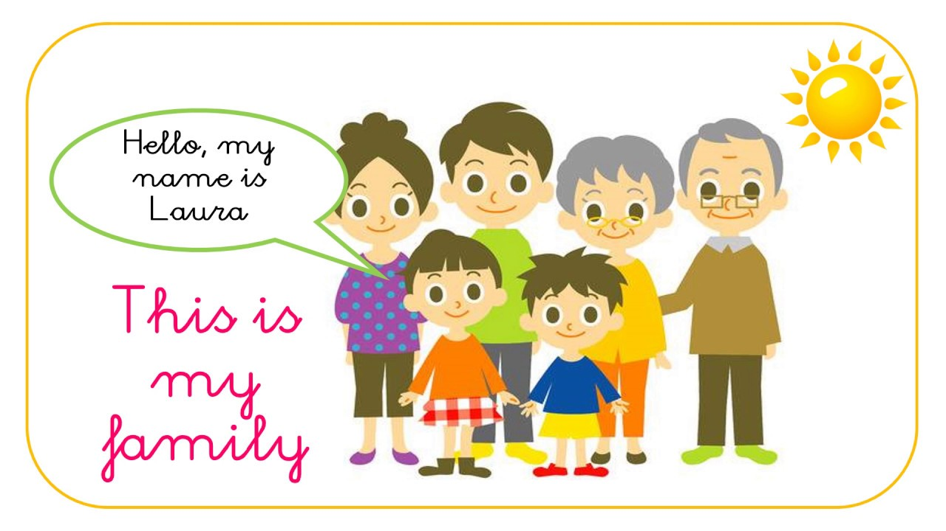

Slide 12
If you have any questions, ask me!

